Slide 1

Assignment2: Online meeting booking system
G33 Members
Lekun.Liu 2255714
Yiyang.Han 2252155
Junhao.Huang 2256792
Yichuan.Zhang 2251668
Tiantian.Ye 2251663
Ruiyang.Wu 2257387
Daiyan.Wu 2257475
Weizhe.Sun 1927150
Xuning.Hu 2251992

Slide 2
Overview
Part 1
Part 2
Part 3
Part 4
Part 5
Introduction
& Background
Architectural
Design
Software Design
Software
Testing
Project Conclusion

Slide 3

Introduction & Background
The development of a web-based online meeting booking system for a university's meeting room management
A high-quality, efficient, user-friendly, and secure system that enables convenient management and meeting room reservations
Meet all kinds of customer’s specification
Aims of our project

Slide 4
Introduction & Background
Efficient meeting room reservation process
Real-time access to room availability
Clear room descriptions
Photos of meeting rooms
Email confirmation and notification for
registration
Staff and student users
Regular Access
User Characteristics
Manage feedback and maintenance Requests
Manage meeting rooms, equipment, booking
approvals, and user permissions
Administrator
Superior Access
Integration Complexity: Compatibility risks with Spring Boot, MySQL, Qiniu, etc.
Usability Challenges: Unintuitive filters, calendar, or email flow may reduce adoption
Data Breach & Unauthorized Access: Weak session or password handling can expose user data
Injection Vulnerabilities: No rate limit on email code requests may lead to spamming
Ethical Considerations: Mishandling student data may violate university or privacy laws
Project Risks

Slide 5
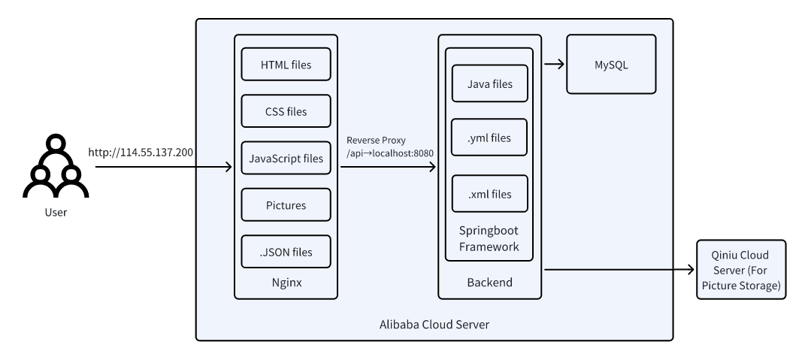
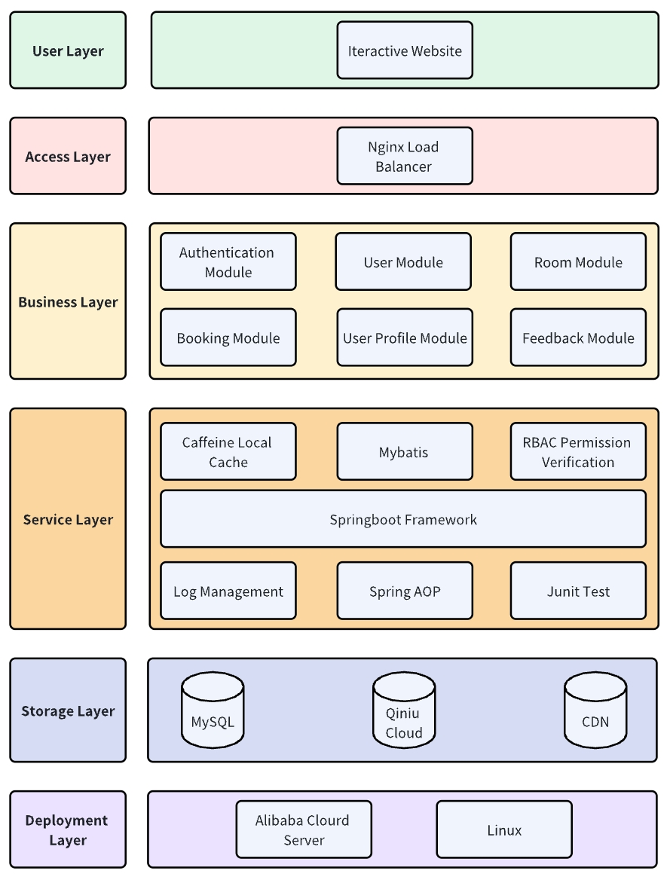
Architectural Design
Five key requirement
Reliability
Performance
Usability
Security
Continuous Improvement
System Components
Frontend: Vue 2, HTML, CSS, JavaScript, Node.js 18.16.0 Backend: Spring Boot 3.0.2, MyBatis-Plus 3.5.3, Java 17.0.8 Database: MySQL 8.0+ OSS: Qiniu Cloud Deployment: Nginx, Ali Cloud Communication: Axios HTTP Client

Slide 6
Architectural Design
HTML, CSS, JavaScript
Manages stateful user interactions
Component-Based Architecture
Enhances frontend scalability and maintainability
Frontend Technology & Justification
Promise-based HTTP client
Handles backend requests more efficiently
Request and response interception
Streamlined error handling and better code organization
Axios HTTP Client

Slide 7
Architectural Design
Spring Boot
Project foundation
Centralized config.
Simplified ORM for SQL mapping and CRUD
Wrapper-based query construction, improving readability.
MyBatis Plus
Backend Technologies & Dependencies
Allows the specified method action to be performed before or after method execution. It is used for log management and permission verification.
Spring AOP
Caffeine
Lightweight local cache to enhance system performance
High concurrency and low latency for frequent data
Qiniu OSS
Image storage integration via secure object storage Supports file upload and CDN delivery with minimal setup
Knife4j provides API documentation UI for RESTful services
Allows interactive API exploration with parameter editing and live response
Knife4j

Slide 8
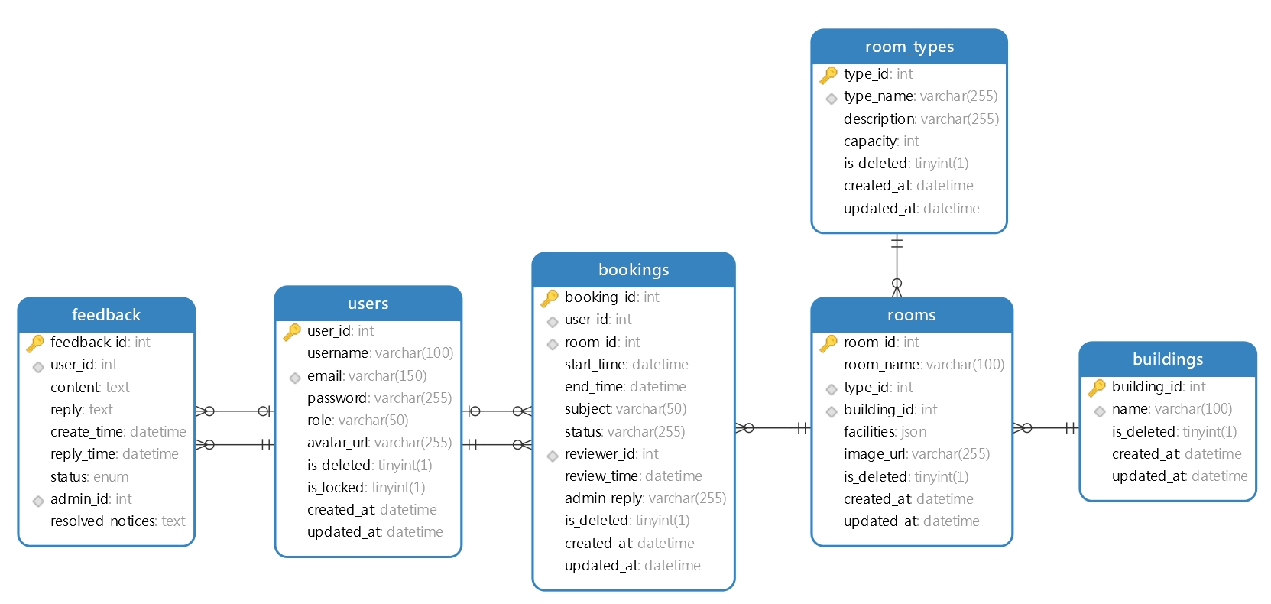
Architectural Design
High-level Database Design
users to bookings: 1:M
users to feedback: 1:M
rooms to bookings: 1:M
room_types to rooms: 1:M
buildings to rooms: 1:M
Table Relationships
users.user_id => bookings.user_id
bookings.room_id => rooms.room_id
users.user_id => bookings.reviewer_id
users.user_id => feedback.user_id
users.user_id => feedback.admin_id
room_types.type_id => rooms.type_id
buildings.building_id => rooms.building_id
Table Foreign Keys

Slide 9
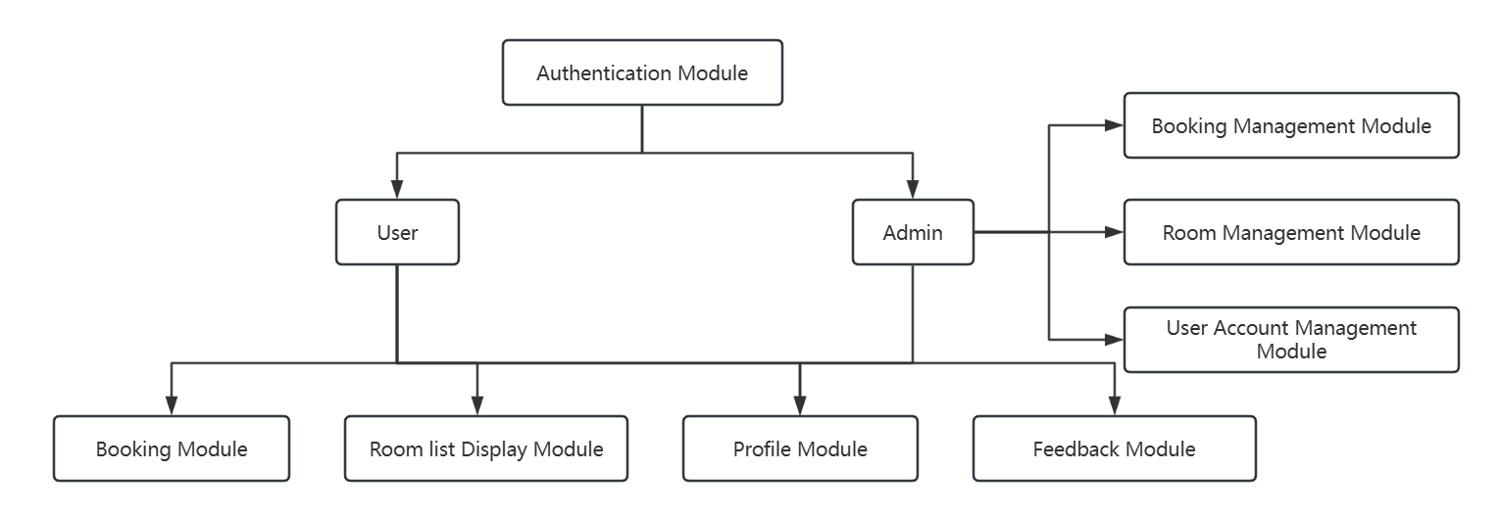
Software Design
Software Modules

Slide 10
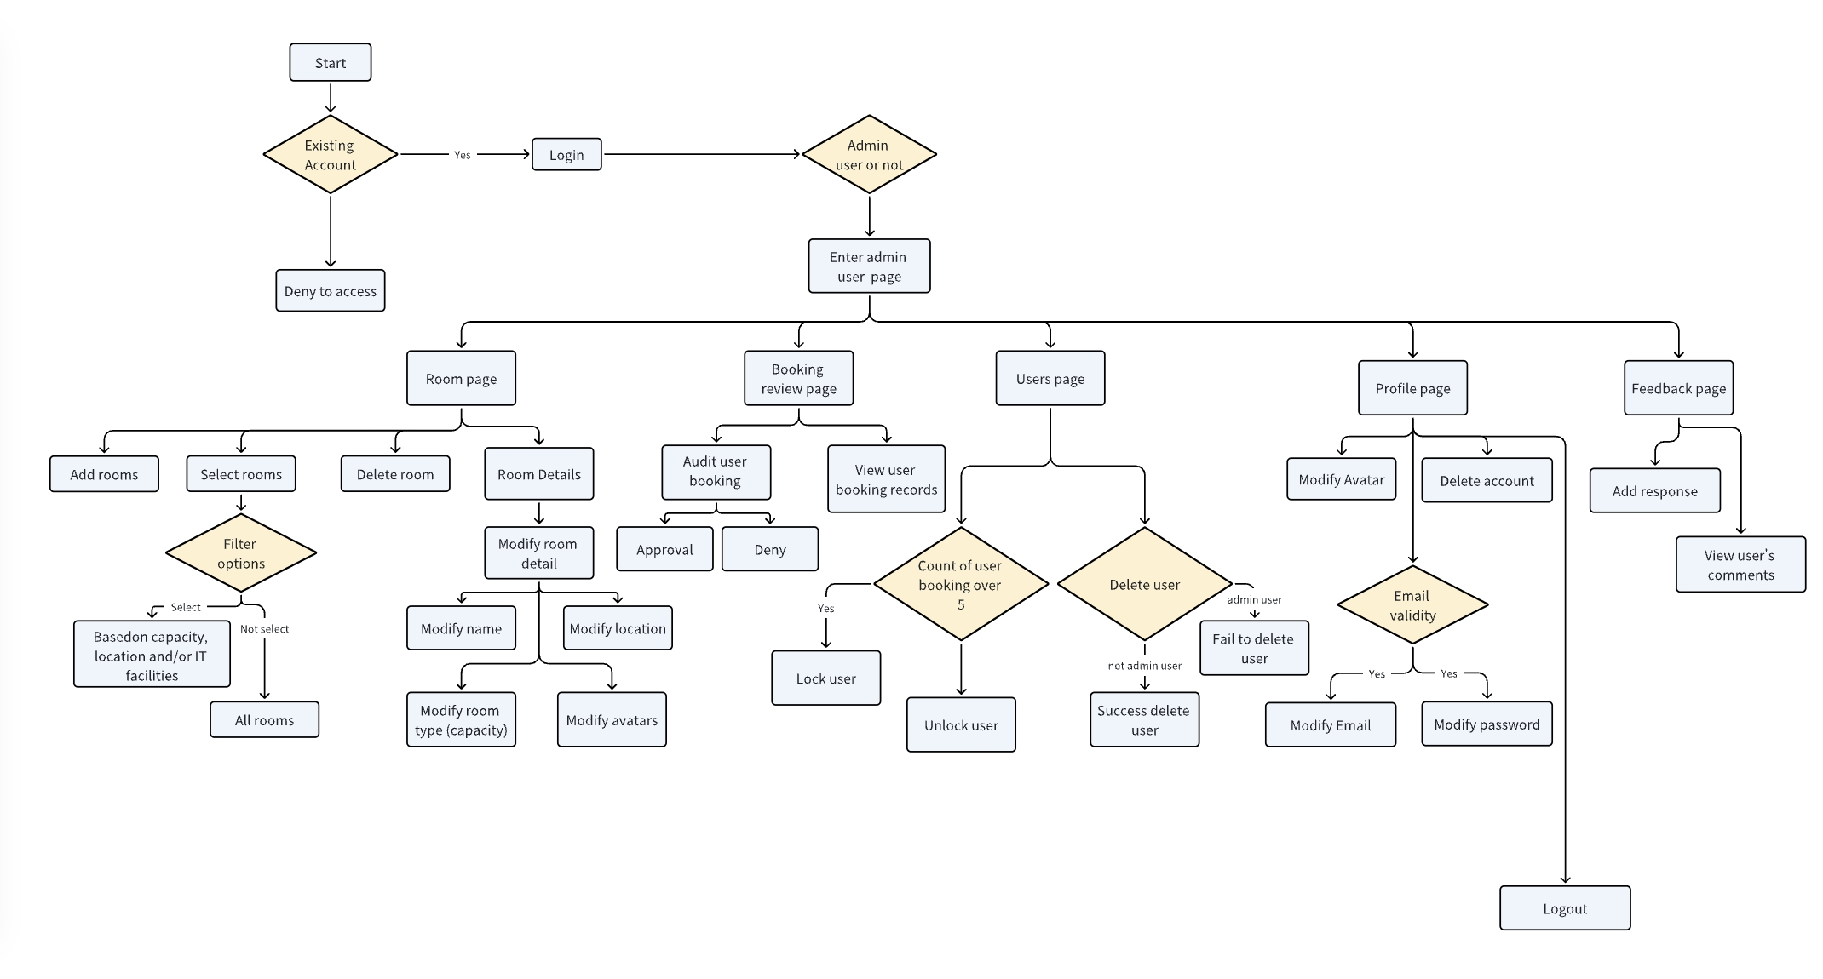
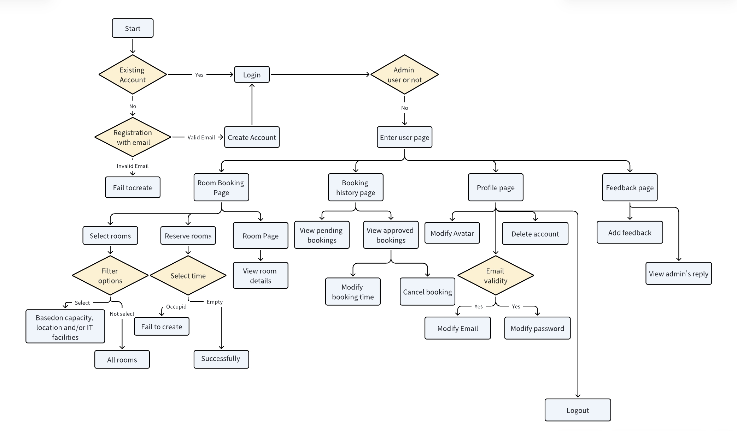
Software Design
High-level process flow
Admin Activity Diagram
User Activity Diagram

Slide 11
Software Design
MySQL provides relational data storage
MyBatis-Plus simplifies ORM with built-in CRUD
QueryWrapper supports dynamic query building in Java
Database Services
Caffeine Cache stores short-lived data
Hutool Toolkit enables string, file, and object utilities
Caching & Utility Services
Security & Email Services
Passwords hashed via MD5 + Salt, rate-limited Captcha
Email verification sent via NetEase 163 SMTP
Software Support Service
Qiniu Cloud stores user avatars and room images
Supports CDN acceleration & lifecycle management
Cloud Storage & CDN
IntelliJ IDEA (backend) & VS Code (frontend)
Version control with Git + GitHub, CI pipelines for pre-merge validation
Development & Deployment Tooling
RESTful APIs documented via Swagger / Knife4j
Community & troubleshooting support via Stack Overflow and official docs
Documentation & Support

Slide 12
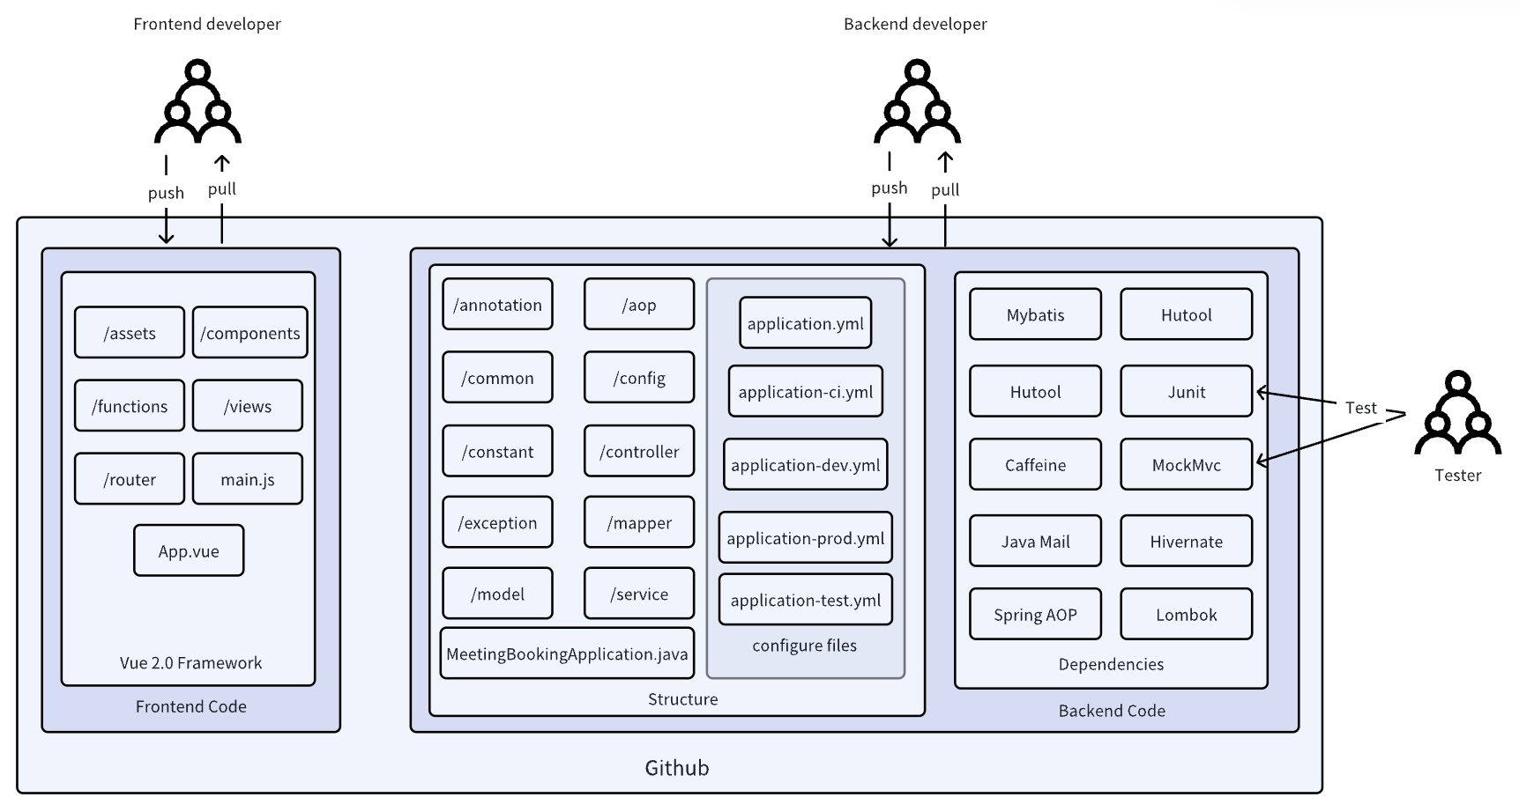
Software Design
Coding Structure
5 Core Principles:
Separation of concerns
High cohesion & Low coupling
Maintainability
Testability
RESTful API design
Layered Architecture:
Controller Layer: Handles HTTP requests
Service Layer: Contains business logic and Mapper Layer SQL abstraction via MyBatis interfaces
Model Layer: Entity classes mapped to DB; DTOs/VOs used for I/O transformation

Slide 13
Software Design
Shared Functional Packages
Shared functional packages help organize reusable logic, simplify configuration, and ensure consistency across the system—making the codebase cleaner, more modular, and easier to maintain.
common/ – Shared tools for response, email, and rate limiting
config/ – Centralized project configuration
constant/ – Global enums for roles and status codes
exception/ – Unified error handling structure
annotation + aop/ – Declarative access control with AOP(Aspect-Oriented Programming)
Coding Conventions
Unified naming
Strict API contracts
Typed errors
Javadoc, logging, and pre-commit linting
Agile workflow with short sprints, CI, code reviews, and daily stand-ups

Slide 14
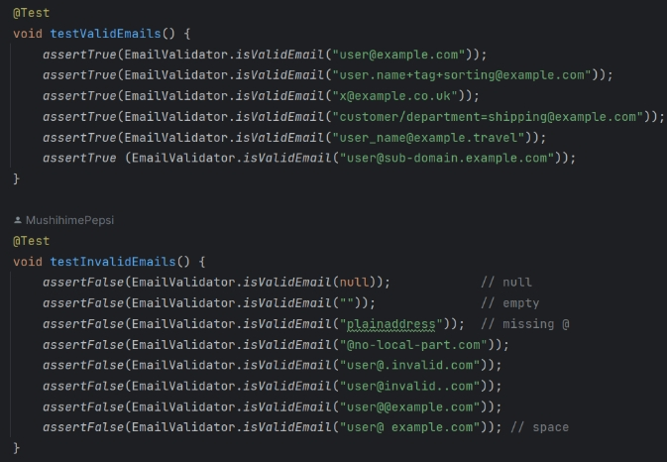
Software Testing – Unit Test
Unit Testing Process
Email format verification (Common Layer): By testing multiple valid and invalid email addresses, ensure that the EmailValidator utility class can accurately verify the email format in accordance with the RFC 5322 standard.
Focus of Unit Testing: Verifying the functionality, correctness, and accuracy of individual code units.
Identify Target Unit: Pinpoint the specific method or class to test.
Understand Expected Behavior: Define expected results for various inputs and conditions.
Isolate the Unit: Use mocks (Mockito) to simulate external dependencies.
Write Test Case (AAA): Arrange inputs, act by calling code, assert expected outcomes.
Run the Test: Execute the test using the framework and check results.

Slide 15
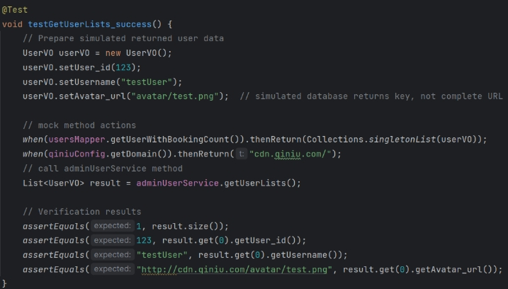
Software Testing – Unit Test
Unit Testing Process
Obtain the user list (Service layer): Use Mockito to simulate dependencies such as Mapper, verify whether the business logic of AdminUserService for obtaining the user list is correct, and correctly assemble and return the data.
Focus of Unit Testing: Verifying the functionality, correctness, and accuracy of individual code units.
Identify Target Unit: Pinpoint the specific method or class to test.
Understand Expected Behavior: Define expected results for various inputs and conditions.
Isolate the Unit: Use mocks (Mockito) to simulate external dependencies.
Write Test Case (AAA): Arrange inputs, act by calling code, assert expected outcomes.
Run the Test: Execute the test using the framework and check results.

Slide 16
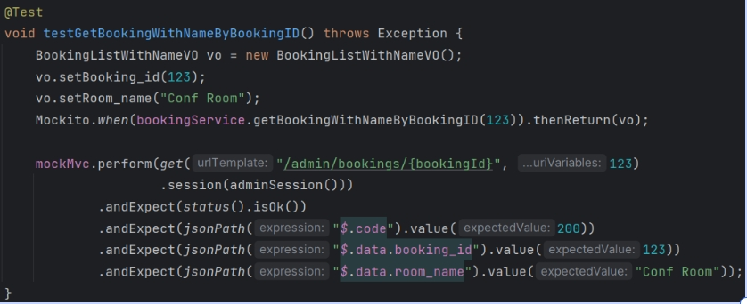
Software Testing – Unit Test
Unit Testing Process
Obtain the reservation by ID (Controller layer): Use MockMvc to simulate HTTP GET requests, and combine Mockito to simulate the Service layer to verify whether the Controller interface for administrators to query reservation information based on reservation numbers can correctly handle and return the expected results
Focus of Unit Testing: Verifying the functionality, correctness, and accuracy of individual code units.
Identify Target Unit: Pinpoint the specific method or class to test.
Understand Expected Behavior: Define expected results for various inputs and conditions.
Isolate the Unit: Use mocks (Mockito) to simulate external dependencies.
Write Test Case (AAA): Arrange inputs, act by calling code, assert expected outcomes.
Run the Test: Execute the test using the framework and check results.

Slide 17
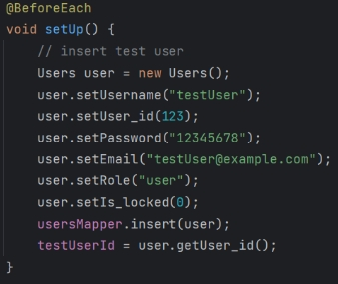
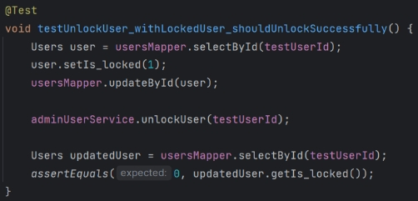
Software Testing – Integration Test
Integration Testing Process
Email send & lock/unlock user function: Test AdminUserService lock and unlock function and checking Service/Mapper interactions and database update. Besides, mocking email sending process.
Focus of Integration Testing: Iterations between different modules. Identify interaction level issues that may be missed when unit testing is performed alone.
Define Scope: Define modules and their interactions for testing together.
Prepare Environment: Set up the test environment, possibly including real dependencies.
Design Scenarios: Create test cases covering key inter-module interactions.
Execute Tests: Run test cases, triggering actual component interactions.
Verify Results: Check outcomes, ensuring correct interactions and data states.
Report & Fix: Log failures; locate and fix discovered integration issues.

Slide 18
Software Testing – Acceptance Test
Acceptance Testing Example:
User booking conference room
Objective:
Users can select an available room and book it for a certain period of time. After reservation, the subscriber can view reservation records.
Test steps:
Login to the system with a test account
Navigate to the "Rooms" page
Filter avilable room list
Choose one meeting room and set a specific meeting time (tomorrow 1900-2100).
Fill in the purpose of the booking ‘Team Meeting’.
Click on the ‘Book’ button.
Result:
Booking information should appear in the ‘My Bookings’ list.
Acceptance Testing Process
Focus of Integration Testing: Validating the system meets project requirements and user needs, ensuring it's ready for deployment.
Define Acceptance Criteria: Define clear pass/fail criteria based on user requirements.
Plan Test Scenarios: Develop real-world user scenarios covering criteria.
Prepare Environment/Data: Set up production-like environment and realistic test data.
Execute Tests: End-users run scenarios simulating real-world usage.
Evaluate Results: Compare actual results against criteria; log defects.

Slide 19
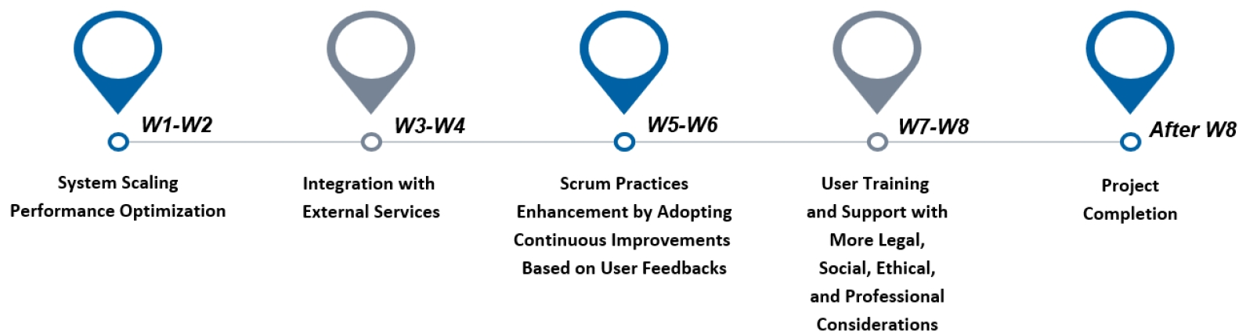


Conclusion
Development of a Web-based Meeting Room Booking System for Universities
Practical Adoption of the Scrum Framework throughout Iterative Sprints
Understanding of Legal, Ethical, and Security Considerations in System Design
Complete System Specification, Design, Implementation, and Evaluation
Achievement
Limited Frontend Styling
Unoptimized Query and Loading Performance
Lack of coping strategies for high-concurrency scenarios
Problems in our project
Future weeks
Future work

Slide 20
References
Noor, G., & Thomas, G. (2021). Aspect-Oriented Programming: Transforming Code Modularity in Spring Ecosystems.
Tran, N. (2020). Applying vue. js framework in developing web applications.
Zhang, F.; Sun, G.; Zheng, B.; Dong, L. Design and Implementation of Energy Management System Based on Spring Boot Framework. Information 2021, 12, 457. https://doi.org/10.3390/info12110457.
Catrina, A. (2023). A Comparative Analysis of Spring MVC and Spring WebFlux in Modern Web Development.
Gajewski, M., & Zabierowski, W. (2019, May). Analysis and comparison of the Spring framework and play framework performance, used to create web applications in Java. In 2019 IEEE XVth International Conference on the Perspective Technologies and Methods in MEMS Design (MEMSTECH) (pp. 170-173). IEEE.
Zhao, J. (2022, June). Application and practice of MVC architecture pattern in on-the-job internship management system. In 2022 International conference on networks, communications and information technology (CNCIT) (pp. 25-30). IEEE.
Grebić, B., & Stojanović, A. (2021). Application of the Scrum framework on projects in IT sector. Eur. Proj. Manag. J, 11(2), 37-46.

